Slide 1


ONBOARDING SESSION
G-IHUB MANAGEMENT

Slide 2
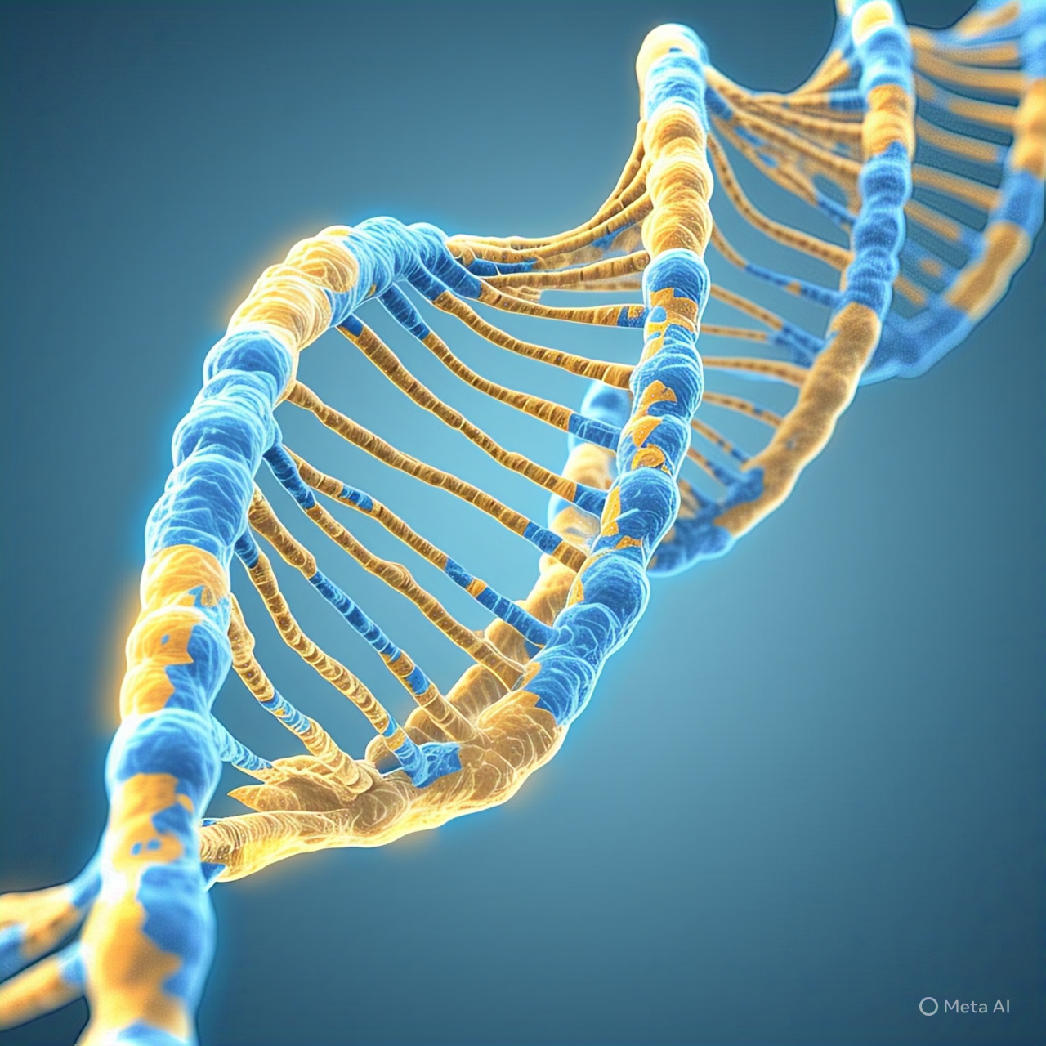

COMPUTATIONAL BIOLOGIST AND FULL-STACK BIOINFORMATICS DATA SCIENCE ENGINEERING BOOTCAMP
(5 Months + Onboarding)
Notes:
© Copyright Showeet.com – Free PowerPoint Templates

Slide 3
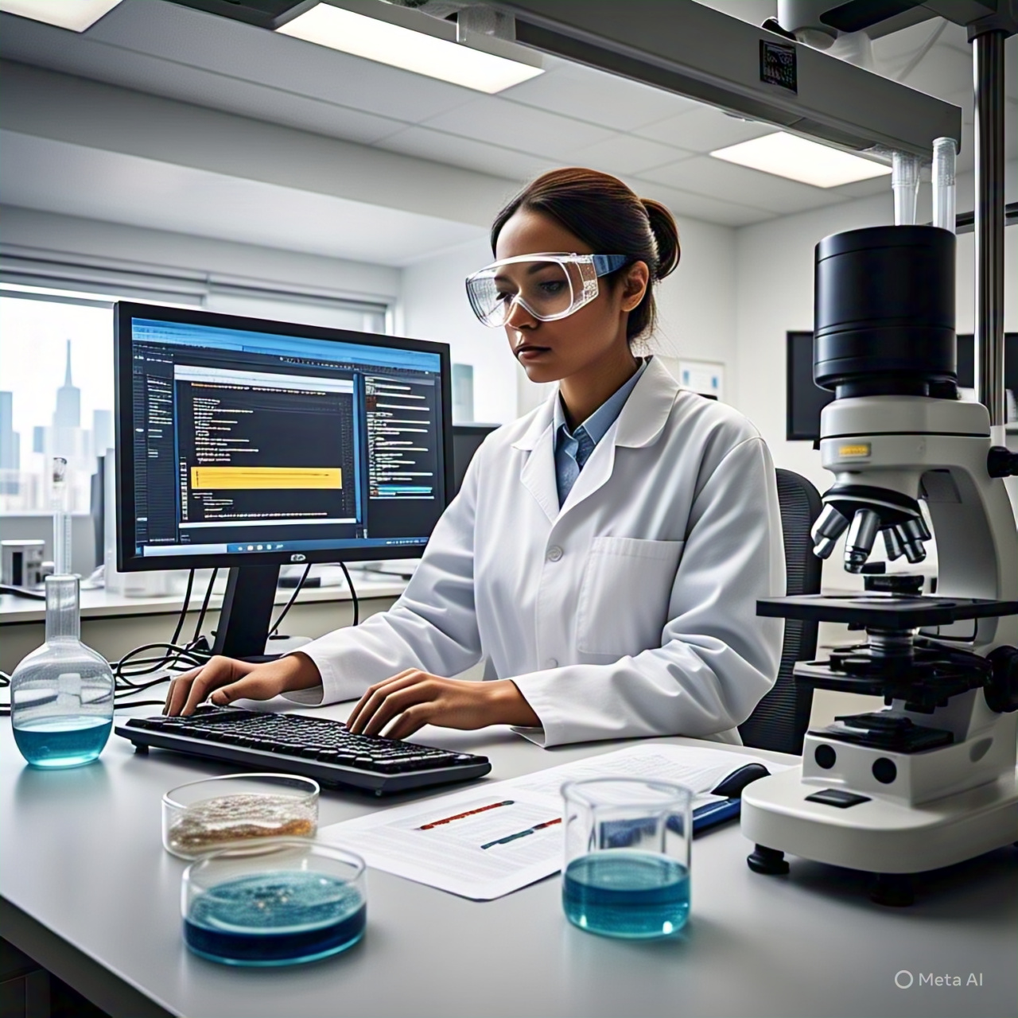
Application of Machine Learning and AI in the Diagnosis of a Common Disease Using Genomic Data
CASE STUDY
Notes:
© Copyright Showeet.com – Free PowerPoint Templates

Slide 4
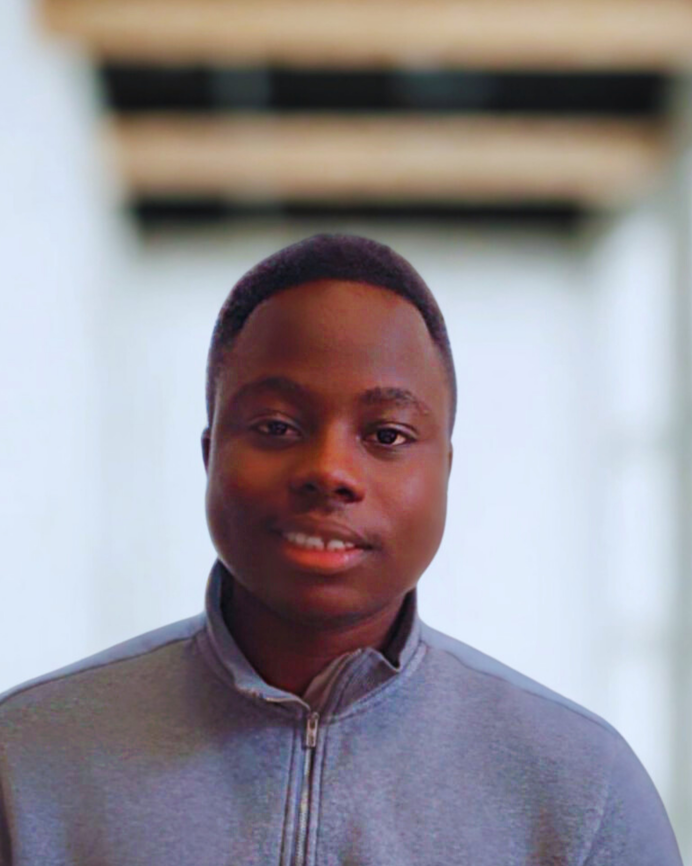


MEET THE INSTRUCTORS
Ayomide Benjamen Oladele
Machine Learning Software Developer and a current PhD Student in USA, with vast experience in teaching and mentoring more than 50 students across different countries mostly in Africa. Previous Instructor of 2025 Cohort.
Joshua Ampofo Yentumi
Cancer Genomics (Ghana)
MPhil student in Biodata Analytics and Computational Genomics, look forward to collaborations and projects that bridge the gap between computational sciences and clinical applications in Africa and beyond
Uchechukwu Stephen Amaefule
Bioinformatics (Nigeria)
a licensed pharmacist with training in pharmacokinetics and clinical therapeutics who transitioned into computational biology and bioinformatics. His work integrates clinical insight with quantitative modeling to translate biological data into actionable decision support tools.
Notes:
© Copyright Showeet.com – Free PowerPoint Templates

Slide 5
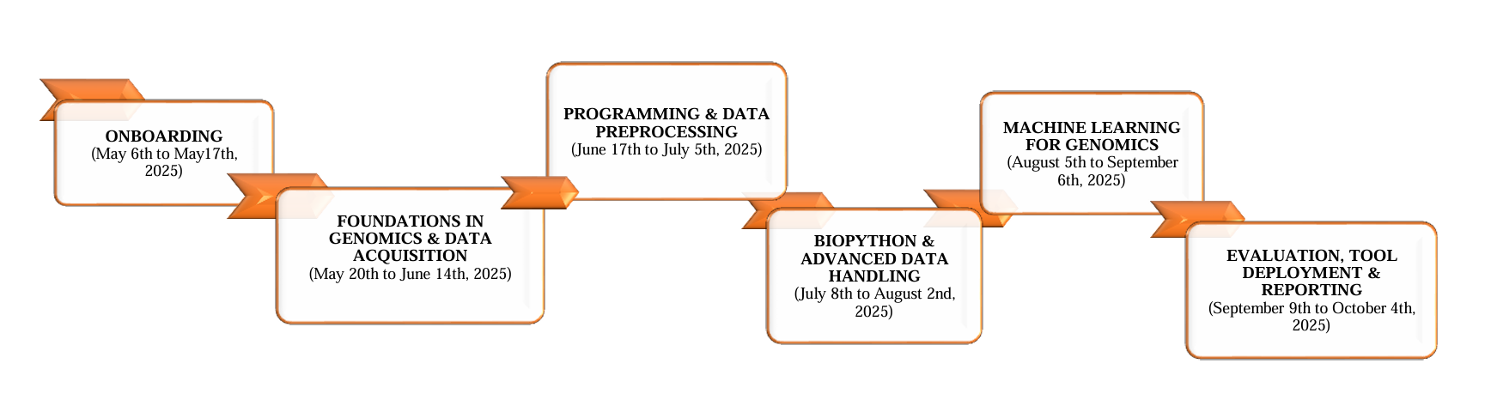

PROGRAM ROADMAP
February 21 – March 7th
March 28th – April 18th
May 23rd – June 20th
March 7th - March 21st
April 25th – May 16th
June 27th – July 18th

Slide 6
PROGRAM STRUCTURE OVERVIEW
Component | Details (with Local Times)
Class Sessions | Every Saturday at 4:00 PM WAT (same times as above for each country)
Mode of Sessions | Live Zoom Sessions + Access to Recorded Videos
Assignments | Weekly Tasks to be Submitted via GitHub
Projects | Monthly Mini Projects & One Final Capstone Project
Career Guidance / Exit Support | Mentorship session focused on practical application of learned skills & career navigation

Slide 7
OVERVIEW OF BIOINFORMATICS & ai applications
BIOINFORMATICS
KEY APPLICATION AREAS
Bioinformatics is an interdisciplinary field that combines computer science, mathematics, and biology to analyze, interpret, and utilize biological data, such as genetic sequences and genomic information.
It involves developing algorithms, statistical models, and software tools to understand complex biological processes and drive discoveries in fields like genomics, proteomics, and personalized medicine.
Genomics & Transcriptomics
Drug Discovery & Precision Medicine
Imaging & Diagnostics (e.g., radio genomics)
Predictive Modeling in Healthcare
AI-powered Biological Data Analysis

Slide 8
EXPECTATIONS & CAREER PATH IN BIOINFORMATICS
EXPECTATIONS
CAREER PATHS
Attend weekly classes
Submit assignments on time
Collaborate on projects
Engage in discussions
Bioinformatics Analyst
Data Scientist in Genomics
AI Researcher in Life Sciences
Clinical Bioinformatics Specialist
Research Assistant / PhD Preparation

Slide 9
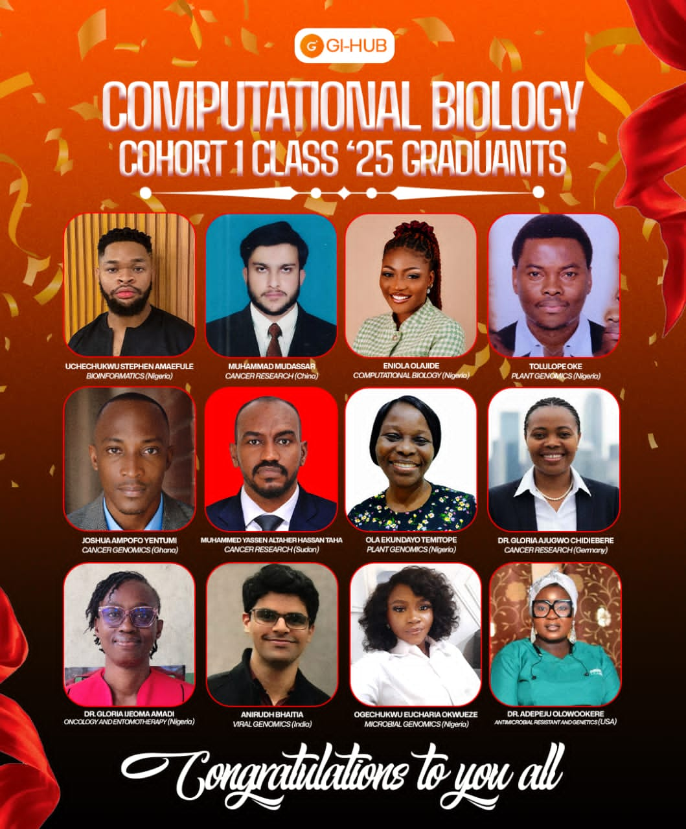

Slide 10
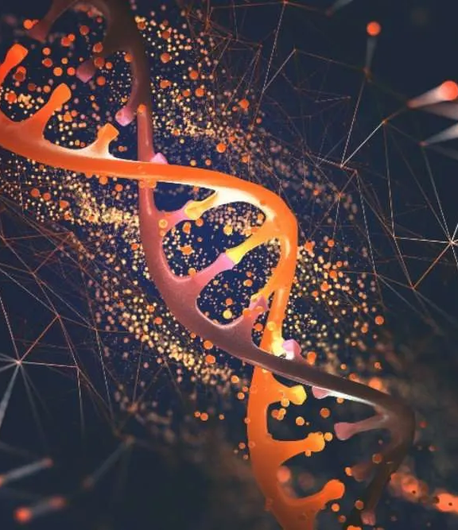

THANK YOU
www.genomachub.com
genomacinnovationhub@gmail.com

